Slide 1
DECISION TREES AND RANDOM FORESTS
Doug Friedman

Slide 2
TODAY’S LEARNING OBJECTIVES
DECISION TREES AND RANDOM FORESTS
Understand and build decision tree models for classification and regression with the sklearn library
Understand and build random forest models for classification and regression
Know how to extract the most important predictors in a random forest model

Slide 3
COURSE
PRE-WORK

Slide 4
PRE-WORK REVIEW
Know how to build and evaluate (classification) models in sklearn
Knowledge of resampling methods
Understand the concepts of cross-validation and overfitting

Slide 5
OPENING
DECISION TREES AND RANDOM FORESTS

Slide 6
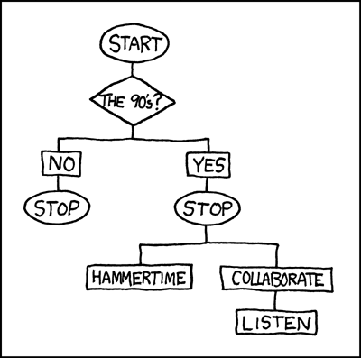
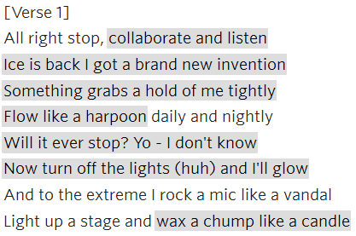
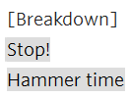
I LOVE (CLASSIFYING) THE 90s
Too Cold – Vanilla Ice (1998)
U Can’t Touch This – MC Hammer (1990)

Slide 7

WHERE ARE WE IN THE DATA SCIENCE WORKFLOW?
Data has been acquired and parsed.
Today we’ll refine the data and build models (We’ll also use plots to represent the results).

Slide 8

WHERE ARE WE IN THE MACHINE LEARNING UNIVERSE?

Slide 9
GUIDED PRACTICE
VARIABLE IMPORTANCE

Slide 10

ACTIVITY: VARIABLE IMPORTANCE
ANSWER THE FOLLOWING QUESTIONS (10 minutes):
EXERCISE
How do we identify the importance of different variables in regression models?
How do we identify the importance of different variables in classification models?
DELIVERABLE
Answers to the above questions

Slide 11
INTRODUCTION
DECISION TREES

Slide 12
DECISION TREES
Decision Trees are a machine learning model for regression and classification that develops a series of yes/no rules to explain the differences present in the outcome variable.
1
y
2
2 Red, 1 Blue
3
y
Is X > 0?
x
True
False
x
0 Red, 1 Blue
2 Red, 0 Blue
4
2 Red, 1 Blue
5
y
Is X > 0?
True
False
x
0 Red, 1 Blue
2 Red, 0 Blue

Slide 13
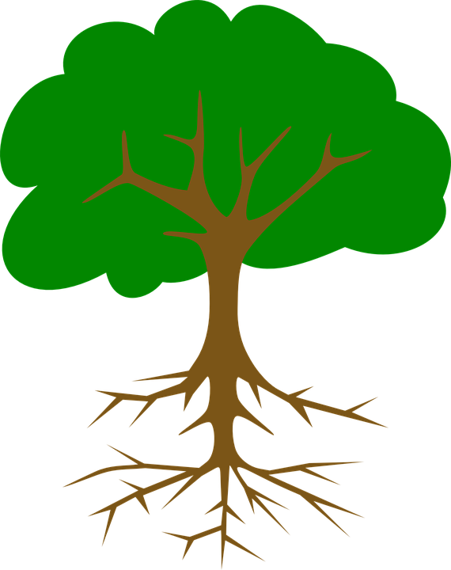


DECISION TREES
When displayed, these series of rules appear as a tree with several branching paths or splits.
The starting point of a decision tree is referred to as the root and subsequent branching points are called nodes. Nodes that do not split further are then called leaves.
Using our example decision tree:
2 Red, 1 Blue
Is X > 0?
True
False
0 Red, 1 Blue
2 Red, 0 Blue

Slide 14
DECISION TREES
The structure of a decision tree is determined by what yes/no rules will best predict the outcome variable.
This is measured at each point of a decision tree by the gini impurity which measures the homogeneity of the outcome variable in a dataset from 0 (uniform) to 1 (inconsistent).
Each rule in a decision tree decreases the gini impurity in the data until it approaches 0.
For regression trees, MSE (or mean squared error) is often used in place of gini impurity.

Slide 15
GUIDED PRACTICE
GROW YOUR OWN TREES

Slide 16
ACTIVITY: GROW YOUR OWN TREES
DIRECTIONS (10 minutes):
EXERCISE
Build decision trees for the two datasets on the next page.
Once you’re done, ask a neighboring team if they grew the same decision trees. Did they come up with a different result?
DELIVERABLE
Answers to the above questions

Slide 17
ACTIVITY: GROW YOUR OWN TREES
Dataset A
Dataset B
y
y
3
2
x
x
-3
-2
Hint: You may want to use the tick marks!

Slide 18
DEMO
DECISION TREES

Slide 19
DECISION TREES
Open up starter-code-12 and we’ll take a look at how to build (and visualize) decision trees with the sklearn library.

Slide 20
GUIDED PRACTICE
TUNING
TREES

Slide 21
ACTIVITY: TUNING TREES
DIRECTIONS (20 minutes):
EXERCISE
Use the provided code to perform a grid search (with k-fold cross-validation) to identify the optimal parameters for a decision tree.
Use the official sklearn documentation about decision trees to identify the correct range for your tuning parameters.
Use either accuracy or the adjusted rand score to score your model.
Visualize your final model using graphviz.
DELIVERABLE
Answers to the above questions

Slide 22
INTRODUCTION
PROS AND CONS
OF DECISION TREES

Slide 23
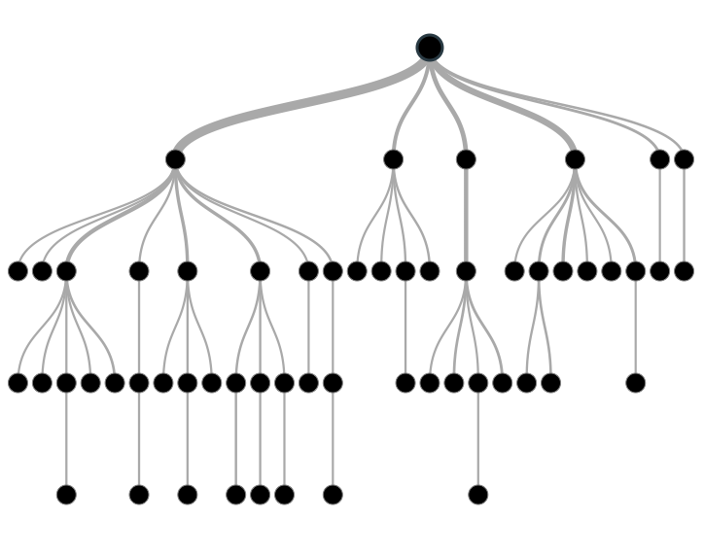
PROS AND CONS OF DECISION TREES
Decision trees are non-linear (a change in a predictor variable has a constant change on the output variable) which gives them more flexibility over linear models (e.g. linear regression).
Decision trees also produce easily interpreted visuals from which variable importance can be derived.

Slide 24
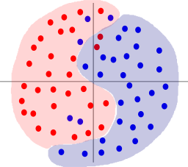
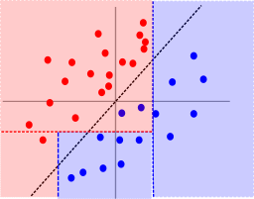
PROS AND CONS OF DECISION TREES
Decision trees are computationally intensive relative to other models, especially if you don’t prune them.
Decision trees are sometimes too flexible and can easily overfit your data. Cross-validation and tuning are key to keeping decision tree models generalizable.

Slide 25
GUIDED PRACTICE
TREE QUIZ

Slide 26
ACTIVITY: TREE QUIZ
ANSWER THE FOLLOWING QUESTIONS (10 minutes):
EXERCISE
Why would a decision tree be liable to overfit?
What is the difference between agglomerative clustering and decision trees?
DELIVERABLE
Answers to the above questions

Slide 27
INTRODUCTION
RUNNING THROUGH THE RANDOM FORESTS

Slide 28
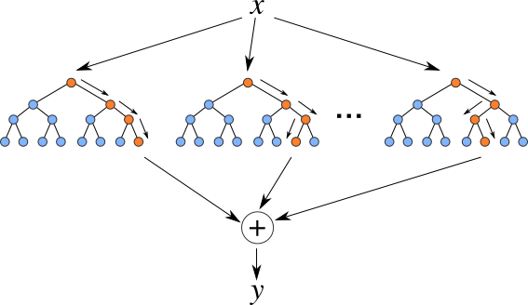
RUNNING THROUGH THE RANDOM FORESTS
Random forest models are one of the most widespread classifiers used because they are relatively simple to use and avoid overfitting.
They do this by ensembling or aggregating the results of several individual decision trees.

Slide 29
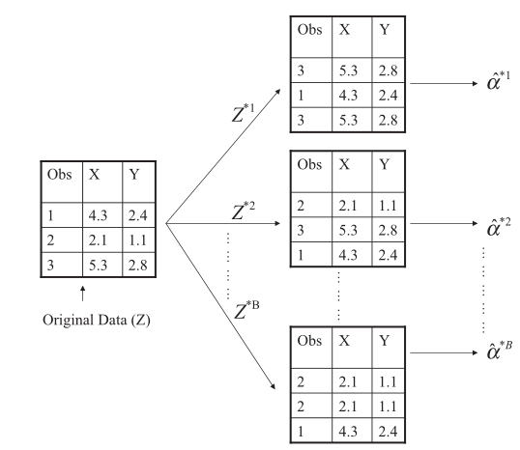
RUNNING THROUGH THE RANDOM FORESTS
Random forests generates many decision trees using another resampling method – bootstrapping.
Bootstrapping differs from cross-validation in two major ways - it creates large samples and allows replacement.

Slide 30
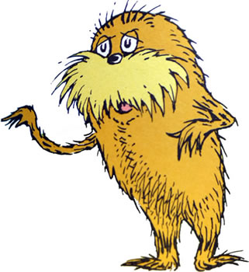
RUNNING THROUGH THE RANDOM FORESTS
For every bootstrapped sample, a decision tree is built and then the results are aggregated to form a random forest.
The idea is that individual trees are likely to overfit, but a set of trees generated from random samples of the original data are unlikely to overfit because each sample will be different.
Only the most significant decision rules will be the same
across different trees in the same forest.

Slide 31


RUNNING THROUGH THE RANDOM FORESTS
This comes with a major tradeoff – random forests are a black box model so we lose the interpretability and visualization of decision trees.
Even though random forests are a black box model, we still have access to all of the same tuning parameters as a regular decision tree plus one more – the number of trees to build before ensembling.

Slide 32
DEMO
RANDOM FORESTS

Slide 33
RANDOM FORESTS
Open up starter-code-12 and we’ll take a look at how to build a random forests model with the sklearn library.

Slide 34
INDEPENDENT PRACTICE
APPLIED FORESTRY

Slide 35
ACTIVITY: APPLIED FORESTRY
DIRECTIONS (40 minutes):
EXERCISE
Use the provided code to fit a random forest model to the California real estate dataset. The goal is to predict the median house value based on the other variables in the dataset.
Is this a regression or classification problem?
Build a decision tree for this data and then examine the results (e.g. visuals, variable importance).
Build a random forest for this data and then examine the results .
DELIVERABLE
Answers to the above questions

Slide 36
CONCLUSION
TOPIC REVIEW

Slide 37
REVIEW Q&A
What are decision trees?
What are some common problems with decision trees?
What are random forests?
What are some common problems with random forests?

Slide 38
COURSE
BEFORE NEXT CLASS

Slide 39
DUE DATE
BEFORE NEXT CLASS
Unit Project 4!

Slide 40
LESSON
Q & A

Slide 41
LESSON
EXIT TICKET
DON’T FORGET TO FILL OUT YOUR EXIT TICKET
LESSON 12
DECISION TREES AND RANDOM FORESTS

Slide 42
CITATIONS
THANKS FOR THE FOLLOWING
Decision Tree Visualization: https://littleml.files.wordpress.com/2012/01/screen-shot-2012-01-23-at-10-00-17-am1.png
90's Flowchart, Munroe, Randall: https://xkcd.com/210/
Questions on some data-mining algorithms: https://stackoverflow.com/questions/4084668/questions-on-some-data-mining-algorithms

Slide 43
CITATIONS
THANKS FOR THE FOLLOWING
An Introduction to Statistical Learning, James, G et al (2013): http://www-bcf.usc.edu/~gareth/ISL/getbook.html
The Lorax (Character), Seuss Wikia: http://seuss.wikia.com/wiki/The_Lorax_(Character)
Classification and Regression Trees, Cosma Shalizi: http://www.stat.cmu.edu/~cshalizi/350/lectures/22/lecture-22.pdf

